Slide 1


Olist Brazilian E-Commerce

Slide 2

AGENDA
1
2
Data Gathering
Data Preprocessing
Data Sources
3
4
Data Integration
5
Paginated Reports
6
Dashboards

Slide 3
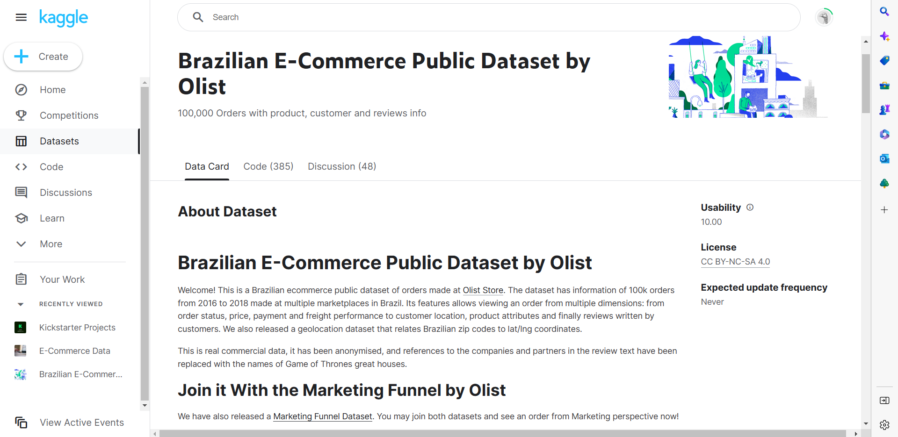

DATA SOURCES
Brazilian E-Commerce Public Dataset by Olist
-This is a Brazilian ecommerce public dataset of orders made at Olist Store. The dataset has information of 100k orders from 2016 to 2018 made at multiple marketplaces in Brazil.
- olist dataset contains 9 tables:
Customer
Geolocation
Order items
Order payments
Order reviews
Orders
Products
Sellers
Category name translation

Slide 4
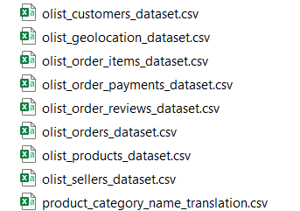
DATA GATHERING
We wanted to expand our data to get more information and get more dimensions and realistic insights
New data sources :
Gathering all data excel sheets ( Kaggle dataset ) Into one database (SQL server DB)

Slide 5
Data Preprocessing
“Deleting Unwanted Columns” “Identifying And Handling The Missing Values”

Slide 6
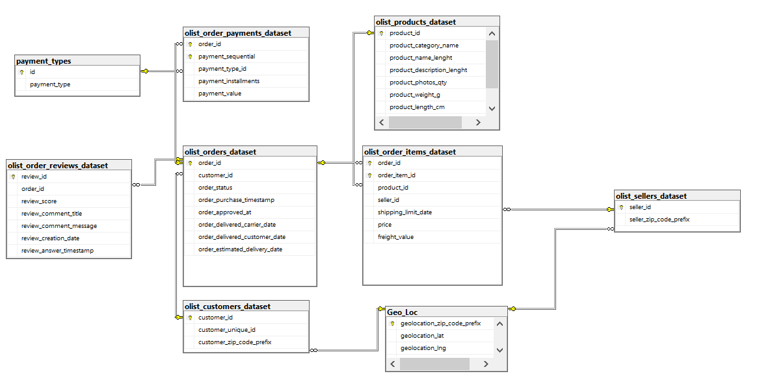
OLTP

Slide 7
DATA INTEGRATION
Build data warehouse structure
- Fact table
- Dimensions tables
Integrate database to the data warehouse
With SQL server integration tool (SSIS)

Slide 8
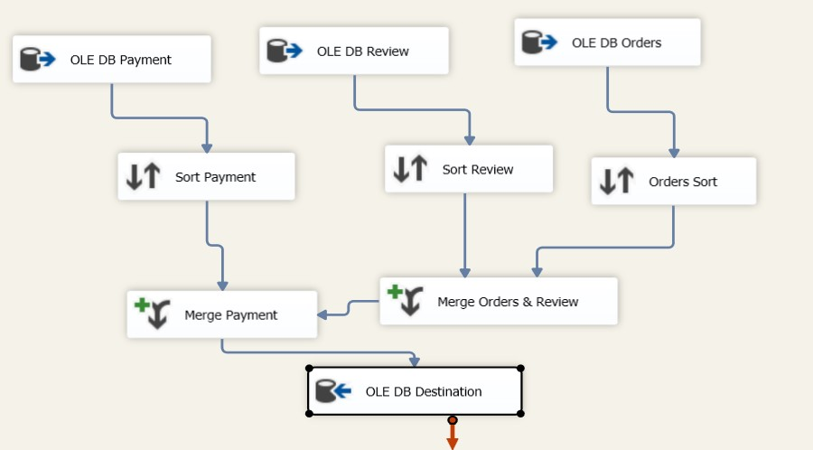

Slide 9
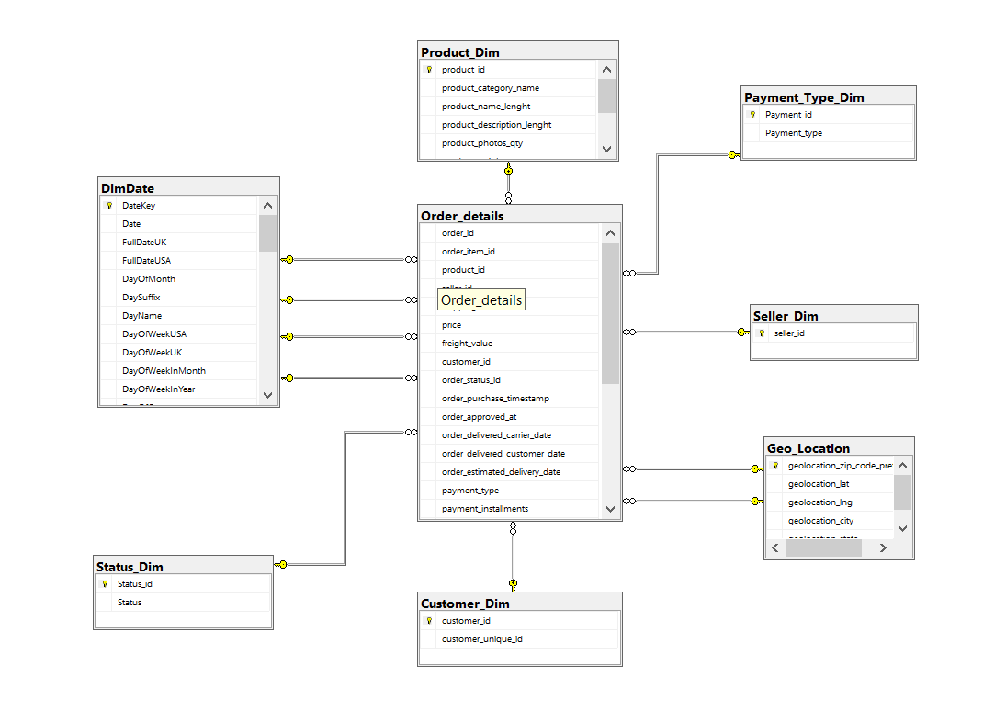
Final Data Warehouse (Star Schema)

Slide 10
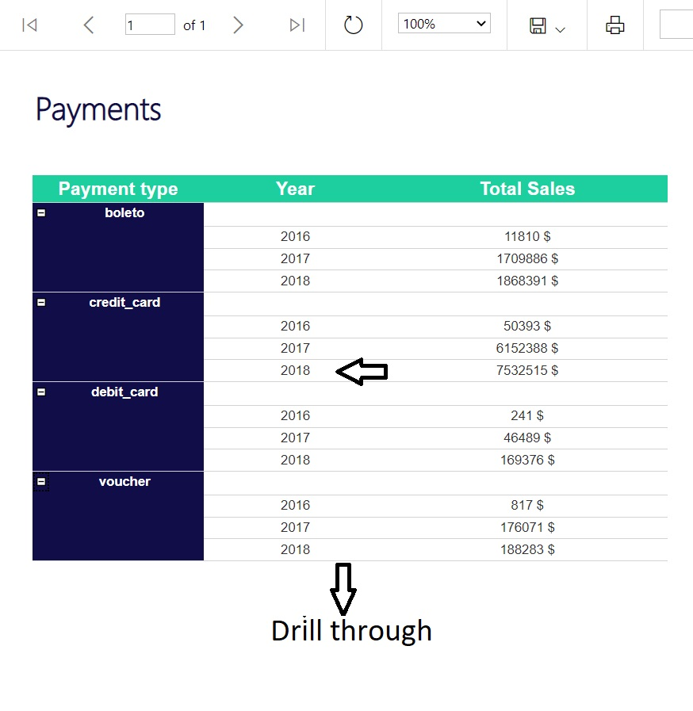
PAGINATED REPORTS

Slide 11
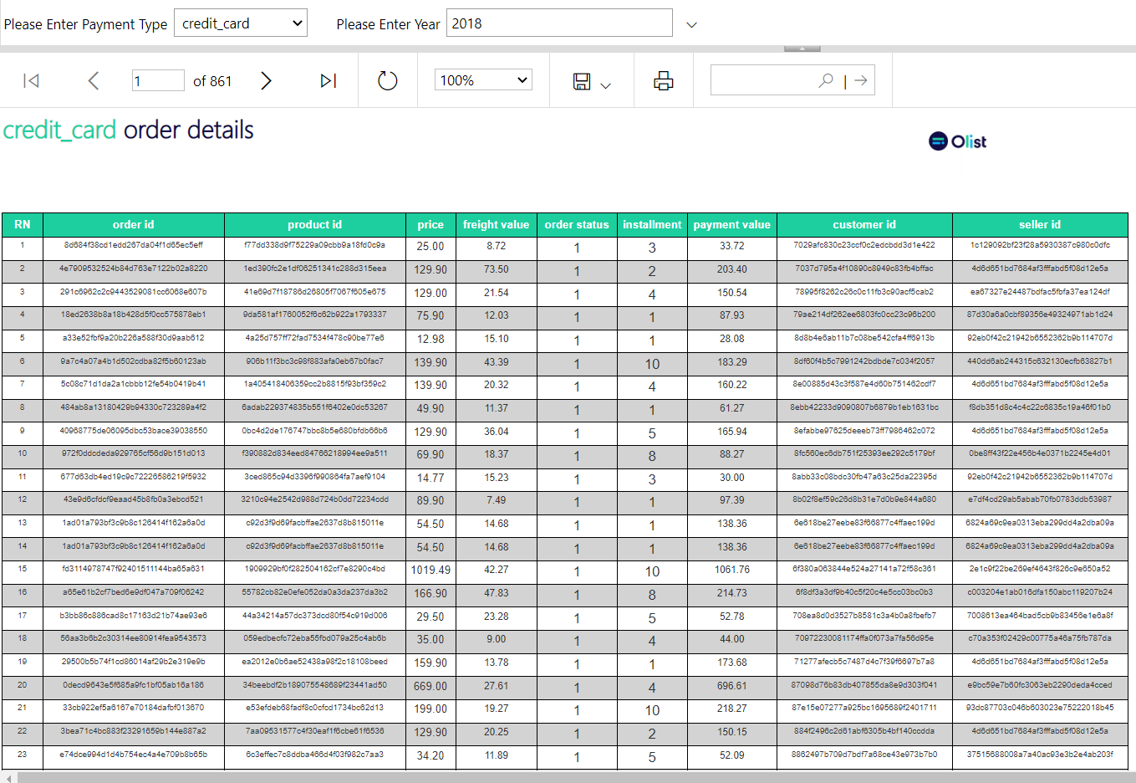
PAGINATED REPORTS

Slide 12
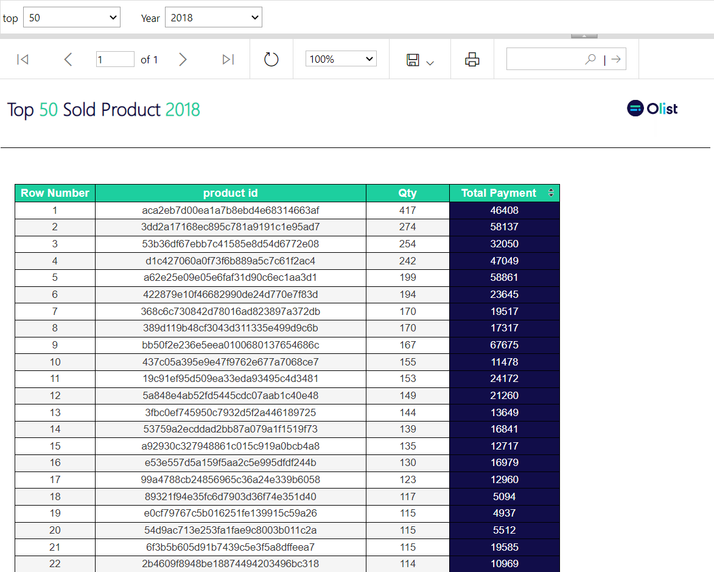
PAGINATED REPORTS

Slide 13
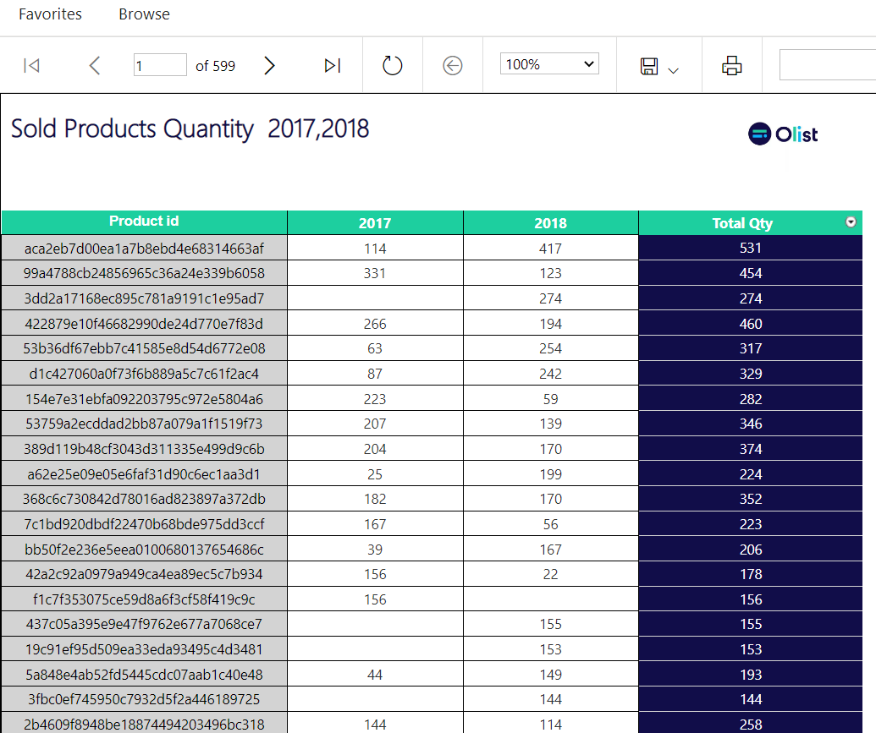
PAGINATED REPORTS

Slide 14
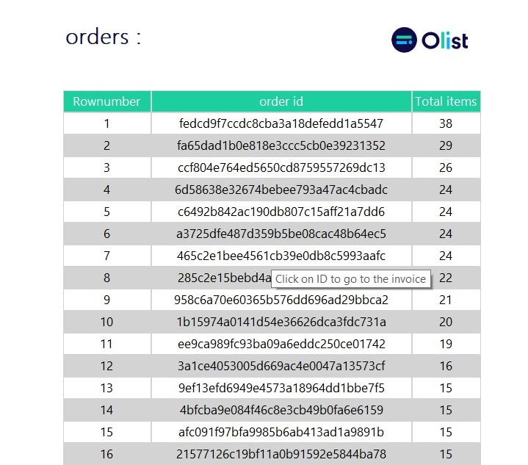
PAGINATED REPORTS

Slide 15
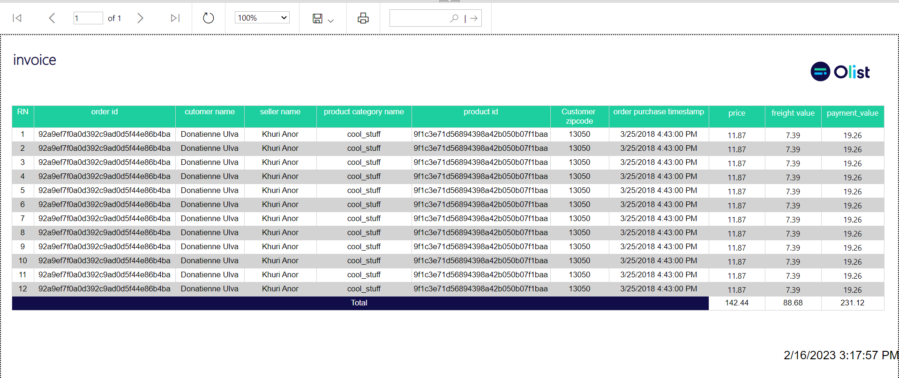
PAGINATED REPORTS

Slide 16
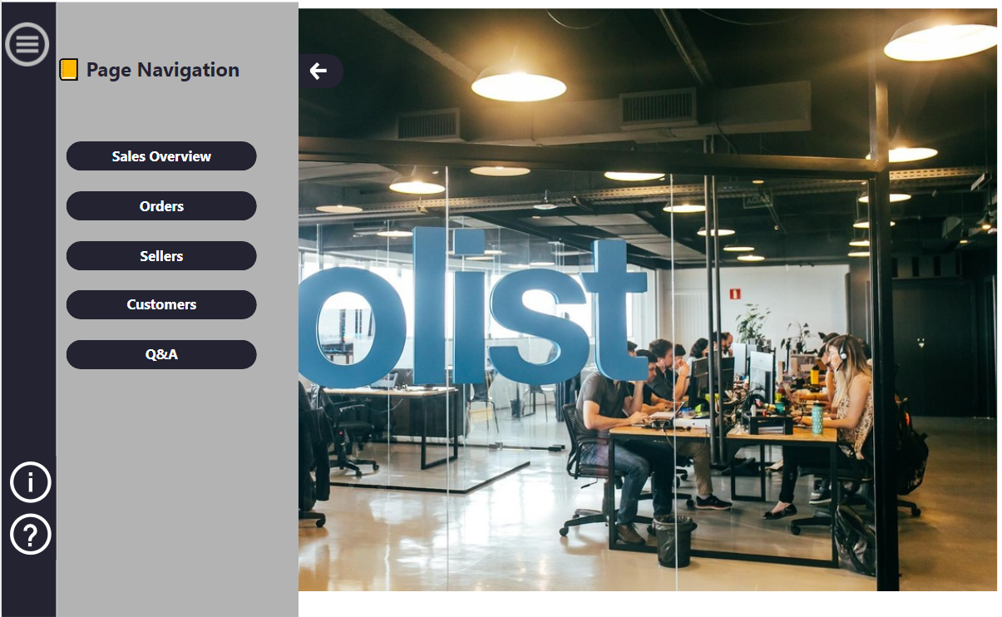
DASHBOARD

Slide 17
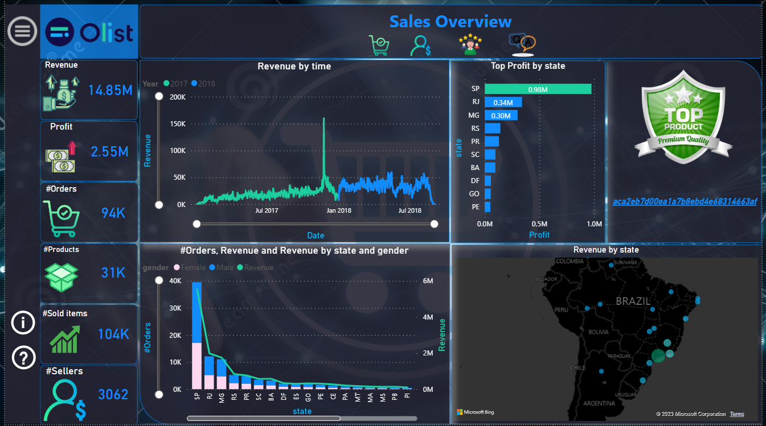

Slide 18
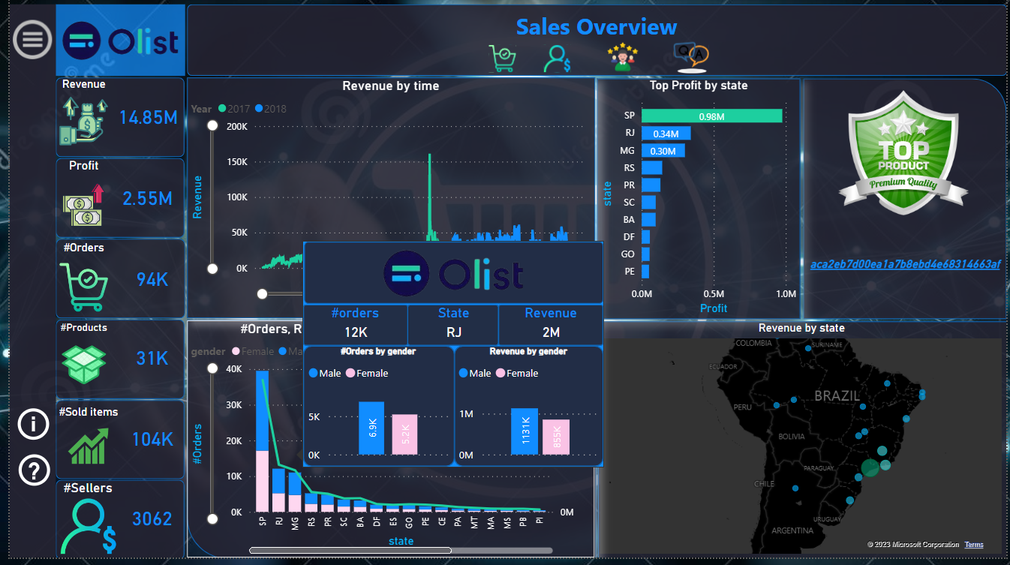

Slide 19
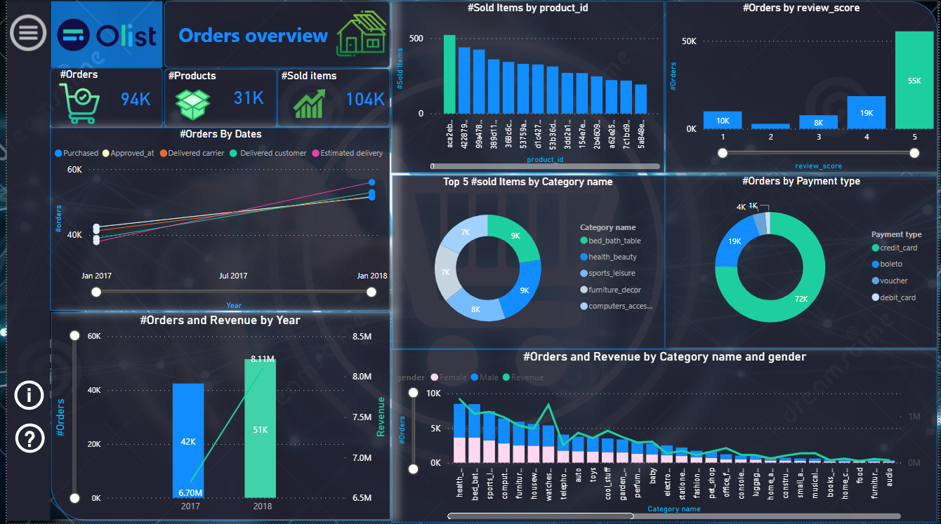

Slide 20
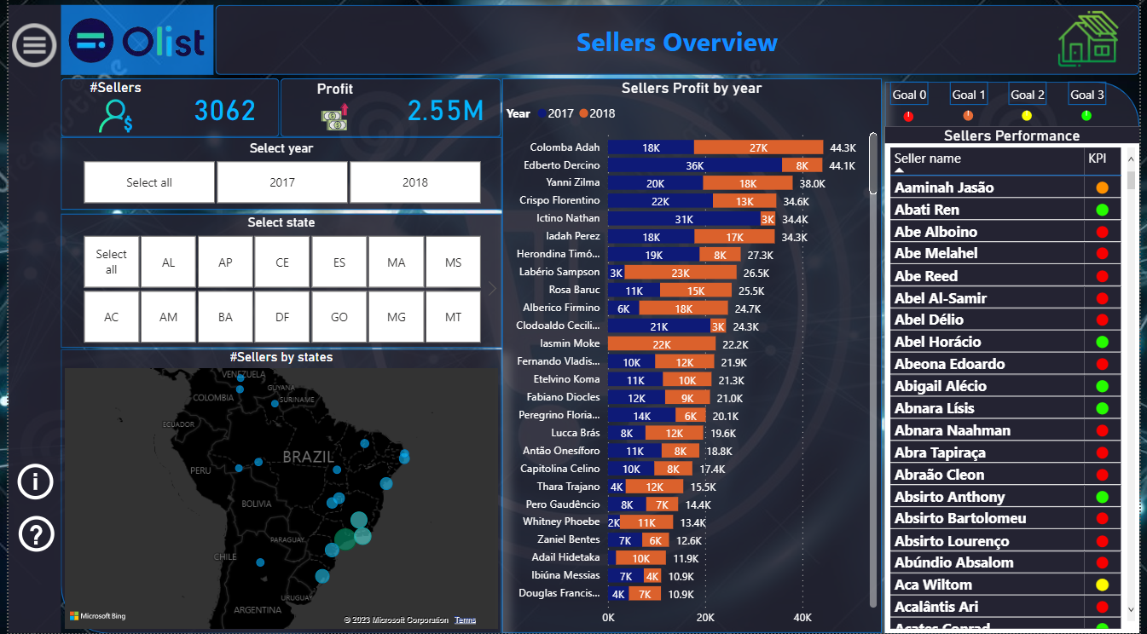

Slide 21
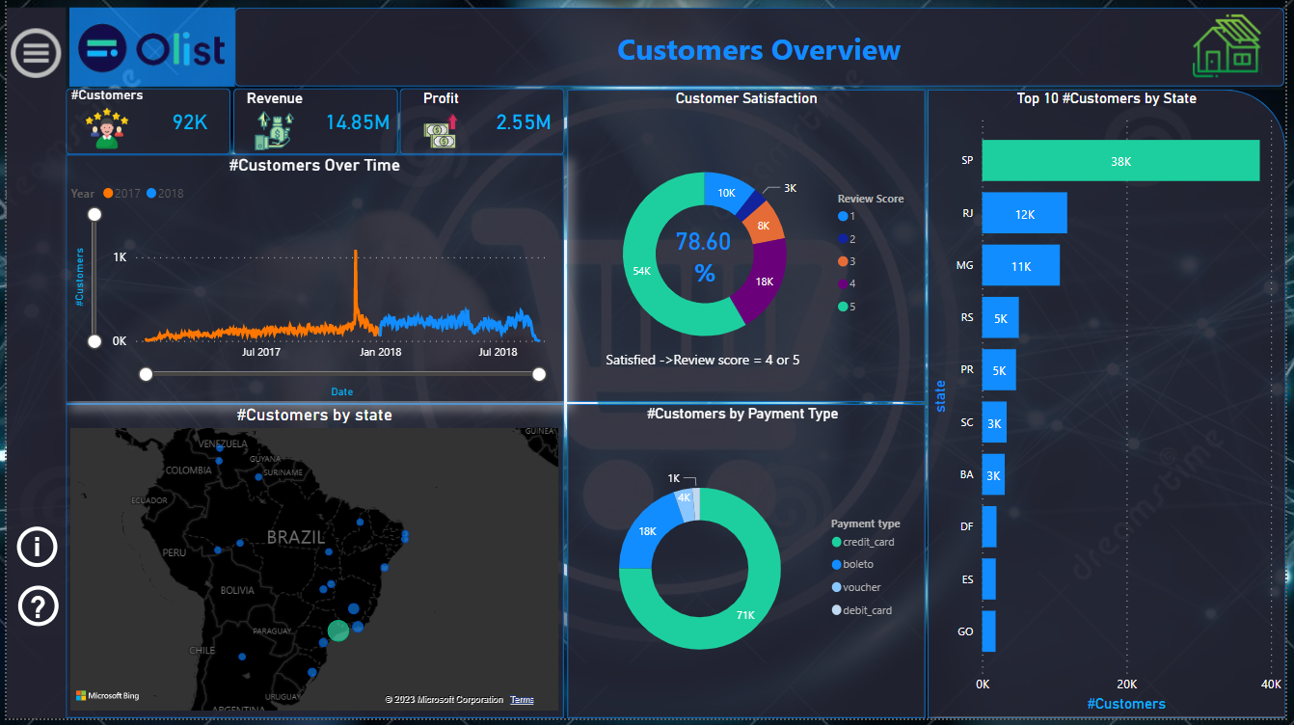

Slide 22
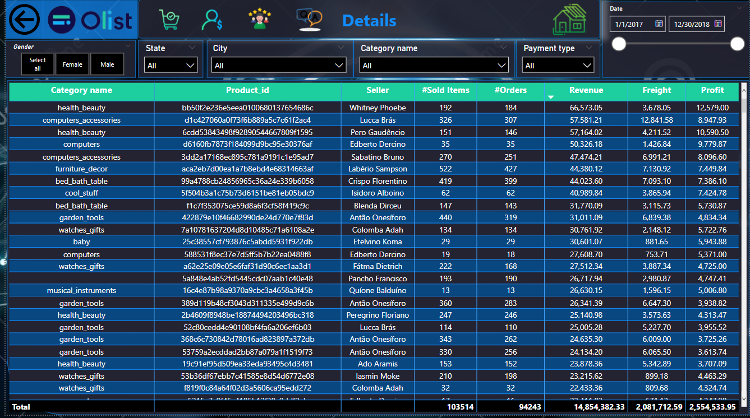

Slide 23
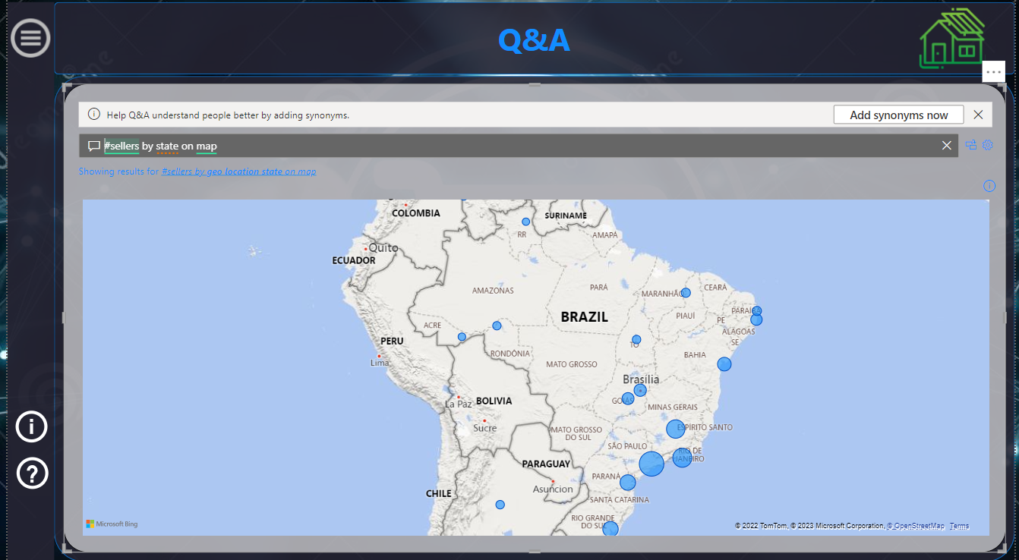

Slide 24
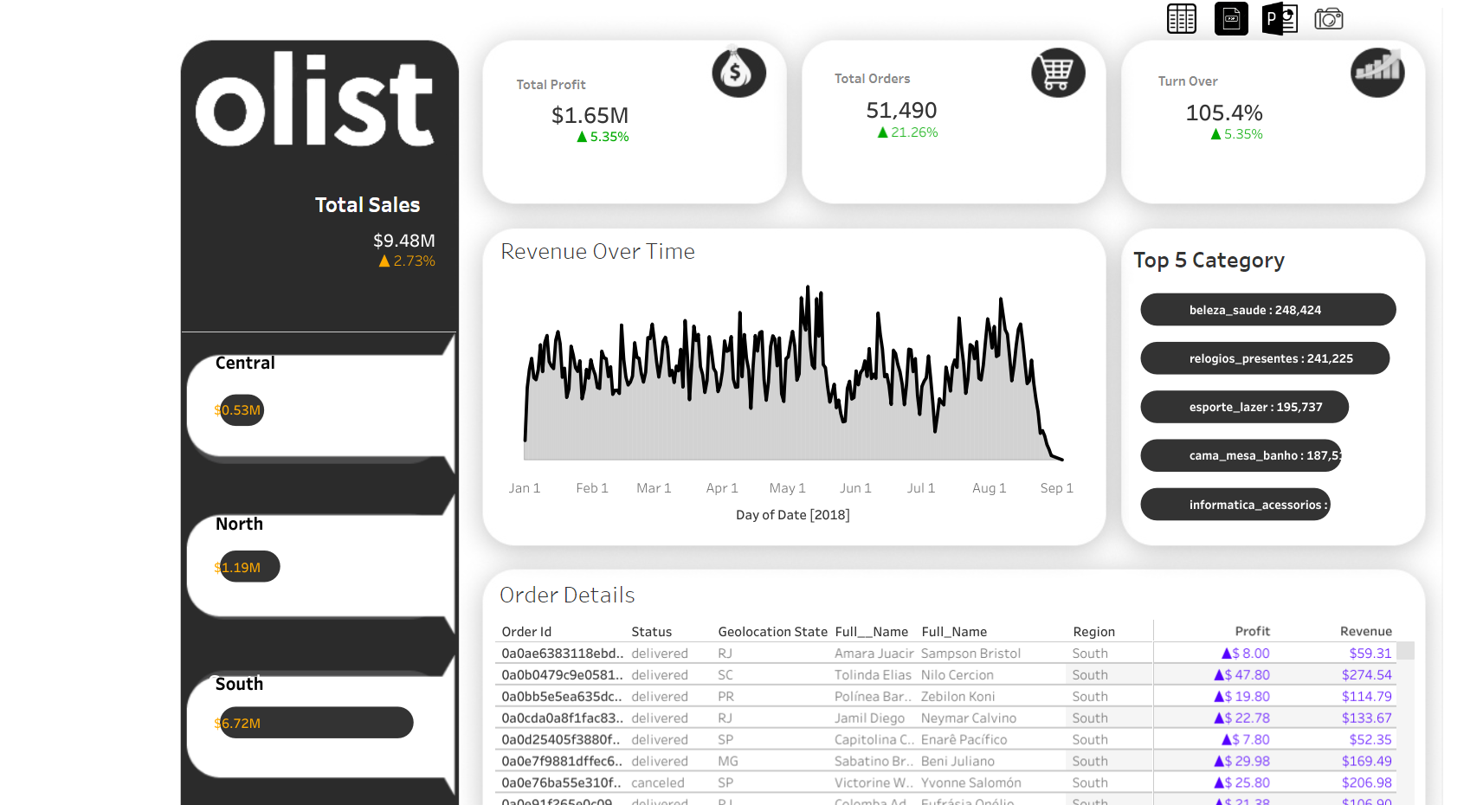

Slide 25
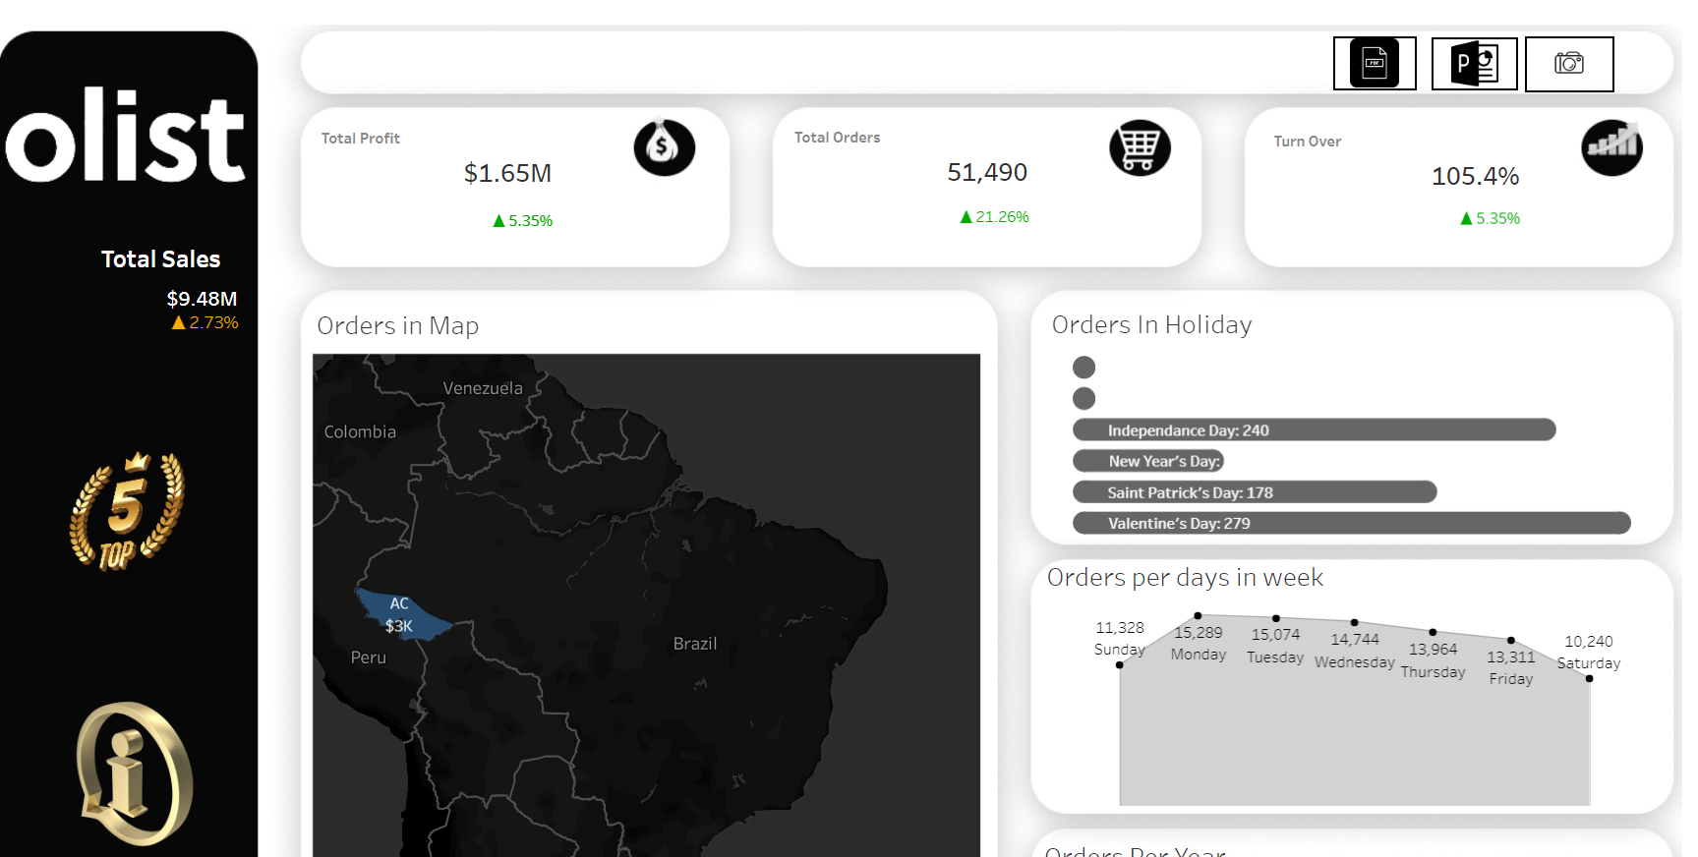

Slide 26
THANKS

